Slide 1
SMART WATER CONTROLLING PUMP
RANJITH KUMARAN G(210701209)
SAM LAWRANCE V(210701225)

Slide 2
INTRODUCTION AND PURPOSE OF THE PROJECT
Water management is crucial in both agricultural and domestic environments, necessitating efficient and adaptable solutions. This project introduces a Smart Water Controlling Pump leveraging IoT and the Blynk platform to optimize water usage. Utilizing a microcontroller (such as Arduino or ESP8266/ESP32) connected to a water pump and sensors (soil moisture, water level, and flow meters), the system monitors environmental conditions and controls the pump accordingly. The Blynk app enables real-time monitoring and remote control via smartphones, providing users with the flexibility to manage water resources efficiently. Key features include automated watering based on sensor data, remote accessibility, data logging for usage analytics, and customizable alerts for prompt action. This system enhances water management by automating and optimizing water distribution, conserving resources, reducing costs, and improving productivity. Future enhancements may incorporate additional sensors and advanced analytics to further improve system adaptability and efficiency.

Slide 3
COMPONENTS USED
ESP32 Wi-Fi Module
DC Water Pump
Relay Switch
Battery
Tubes
Jumper wires

Slide 4
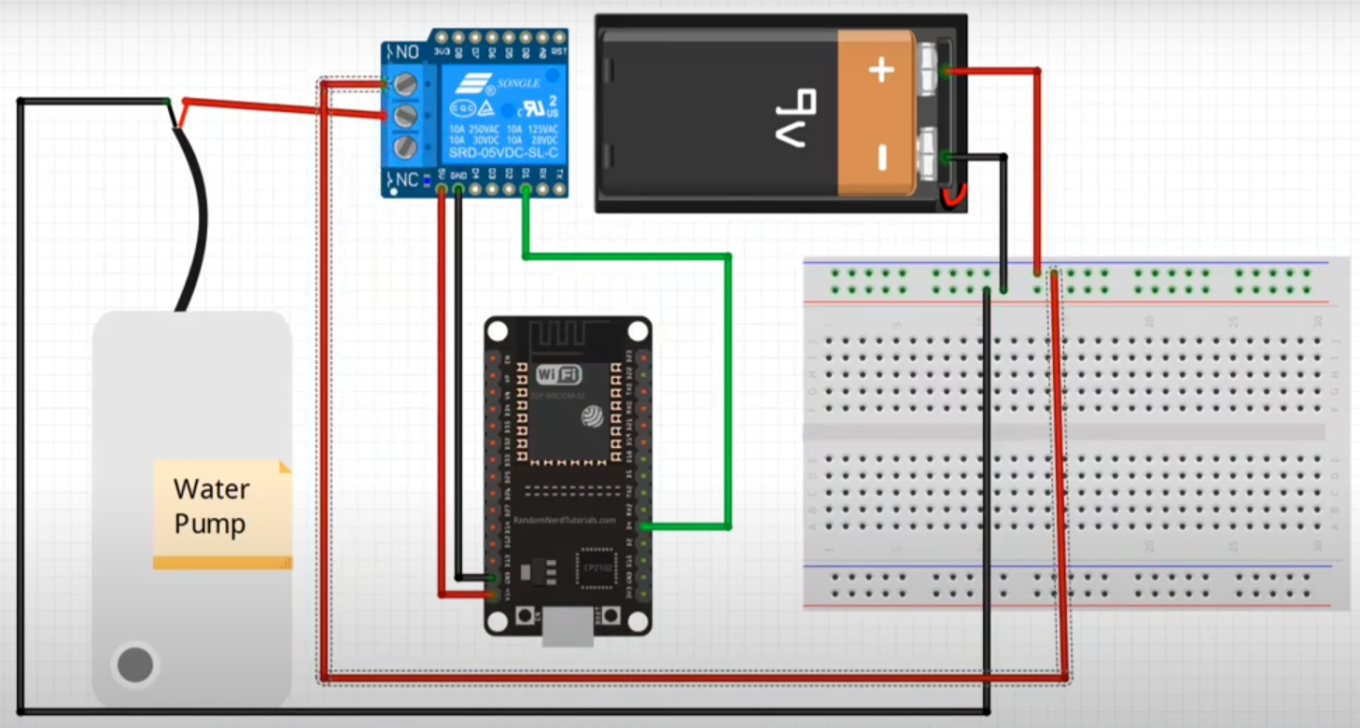
CIRCUIT DIAGRAM

Slide 5
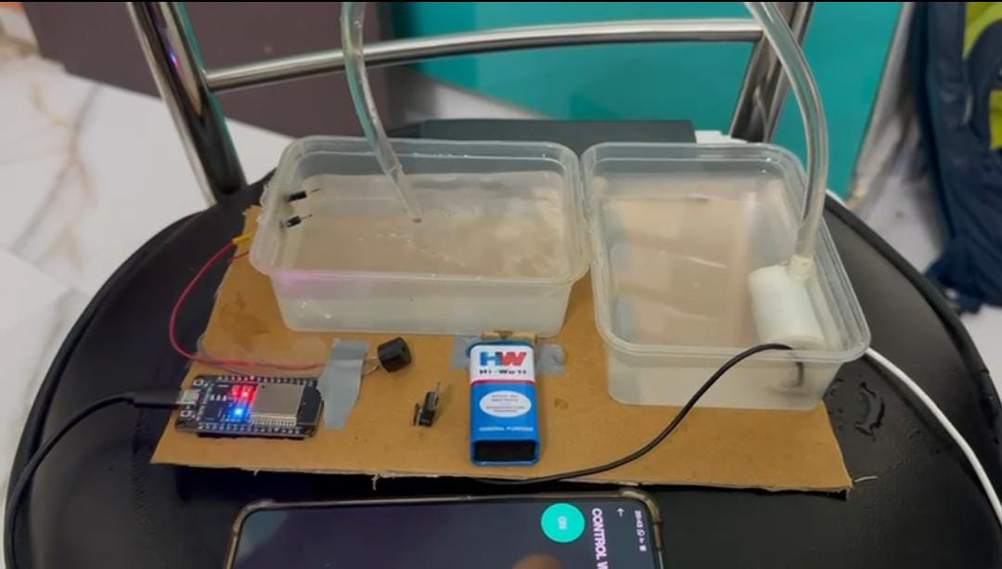
RESULTS

Slide 6
CONCLUSION AND FUTURE SCOPE
In conclusion, the smart water controlling pump system has demonstrated significant potential in optimizing water usage, reducing wastage, and enhancing efficiency in various applications such as agriculture, industrial processes, and residential water management. The system's integration with IoT technology allows for real-time monitoring and control, ensuring that water resources are utilized judiciously. Future enhancements could focus on improving sensor accuracy, expanding connectivity options, and incorporating advanced AI algorithms to predict water needs more precisely. Additionally, integrating renewable energy sources to power the pumps and enhancing data security measures would further augment the system's sustainability and reliability. These advancements will contribute to more intelligent and resource-efficient water management solutions, addressing global water scarcity challenges.

Slide 7
THANK YOU

